Slide 1

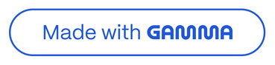
OrangeHRM Testing
Team 1 Presentation

Slide 2

Project Overview
Project Name
Report Date
OrangeHRM-Project
November 15, 2025
Prepared By
Team 1: Kerolos Samuel Awad, Mohamed Radi Goda, Zeyad Osama, Ahmed Ali, Hazem ghobashy

Slide 3

Tested Feature: Save System User
The Save System User page within the OrangeHRM Admin Module is a critical tool for HR administrators. It facilitates the creation, editing, and management of system-level user accounts, ensuring secure and controlled access to the HR system. Administrators can efficiently assign login credentials, define specific user roles, link accounts to existing employees, and meticulously control access permissions.

Slide 4





Key Functionalities Tested
Login Function
Add Employee
Edit Employee
Ensuring secure and reliable user authentication.
Verifying the creation of new employee records.
Confirming accurate modification of employee details.
Delete Employee
Add Personal Details
Leave Function
Validating the removal of employee profiles from the system.
Testing validation of adding personal deatils successfully
Testing the request and management of employee leave.

Slide 5

Objective of This Report
The primary objective of this Test Summary Report is to provide a comprehensive overview of the testing activities conducted for OrangeHRM. This includes presenting:
Overall testing activities and their scope.
Detailed results and coverage achieved during testing.
Summary of identified defects and their impact.
Assessment of the quality status of the application under test.
A clear indication of the product's readiness for release.

Slide 6


Scope of Testing
In Scope
Out of Scope
Functional Testing: Verification of all specified features and functionalities.
Performance Testing: Assessment of system responsiveness and stability under load
UI/UX Testing: Evaluation of user interface and user experience design.
Compatibility Testing: Ensuring functionality across different browsers and OS.
Non-functional Testing: Any non-functional aspects
Integration Testing: Validating interactions between different modules.
Smoke Testing: Quick checks to ensure basic functionalities are working.
Security Testing: Identifying vulnerabilities and protecting data integrity.

Slide 7
Test Approach
Our testing process adhered to a structured and standard Quality Assurance (QA) cycle to ensure thorough coverage and defect identification.
01
02
Exploratory Testing
Test Scenario & Case Creation
Initial flexible testing to discover application behavior.
Development of detailed test scenarios and test cases.
03
04
Test Data Preparation
Manual Test Case Execution
Generation and setup of necessary data for test execution.
Systematic execution of all defined test cases.
05
06
Defect Logging
Re-testing & Regression
Documentation of defects with steps, severity, and screenshots.
Verification of fixes and ensuring no new issues are introduced.

Slide 8

Test Environment
Key Environment Details
The testing was conducted on a dedicated QA platform, ensuring a controlled and consistent environment for accurate results. We tested across multiple leading web browsers and a widely used operating system to guarantee broad compatibility and optimal user experience.
Environment: QA Platform
Browser(s): Chrome, Firefox, Edge
Operating System: Windows 10
Build Version: 64-bit

Slide 9

Test Execution Summary
150
Test Cases Prepared
105
Test Cases Executed
85%
Passed
Failed
Not Executed
Pass Rate
Out of 150 prepared test cases, 105 were executed, achieving an 85% pass rate. This indicates a high level of stability for the tested features.

Slide 10
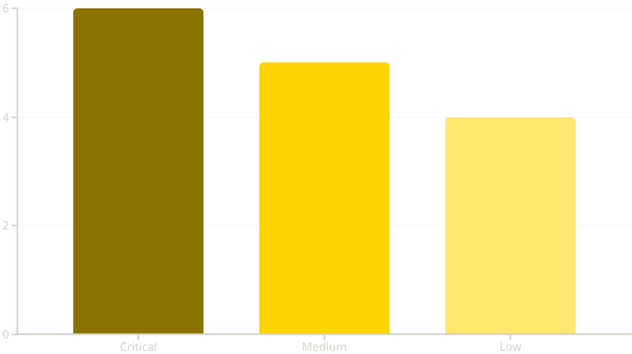




Defect Summary & Test Cases
Total Defects Logged
15 Bugs
Critical Defects
6
Medium Defects
5
Low Defects
4
A total of 15 defects were logged, with a distribution across critical, medium, and low severities. The detailed test cases and their results can be reviewed via the provided link:
Test Cases Link

Slide 11


OrangeHRM Test Automation Framework
QA Team Automation Excellence
A comprehensive automation solution for core OrangeHRM modules built by our dedicated QA team

Slide 12





Team Introduction
Ahmed Ali
Kerolos Samuel
Mohamed Goda
Zeyad Osama
Automation Tester
Automation Tester
Automation Tester
Automation Tester
Login Module
PIM Module
Admin Module
My Info Module
Tools & Technologies
Java, Selenium WebDriver, TestNG, Maven, Page Object Model (POM), IntelliJ IDEA, GitHub, Apache POI

Slide 13
Project Overview
Purpose
Goals
Automate core OrangeHRM modules
(Login, PIM, Admin, MyInfo)
Improve reliability
Reduce manual testing
Build scalable automation
Follow clean POM architecture
Framework Stack
Framework built using Java + Selenium + TestNG using Page Object Model

Slide 14
Automation Framework Architecture
Page Objects
1
src/test/java/pages → Login, PIM, Admin,MyInfo page classes
Test Classes
2
src/test/java/tests → Test scenarios for each module
Utilities
3
src/main/java/utils → Helpers, waits, actions
Test Data
4
src/test/resources/testdata → Excel or JSON data
Base Configuration
5
BaseTest → WebDriver setup, configuration
Execution
6
TestNG XML → Test execution flow

Slide 15
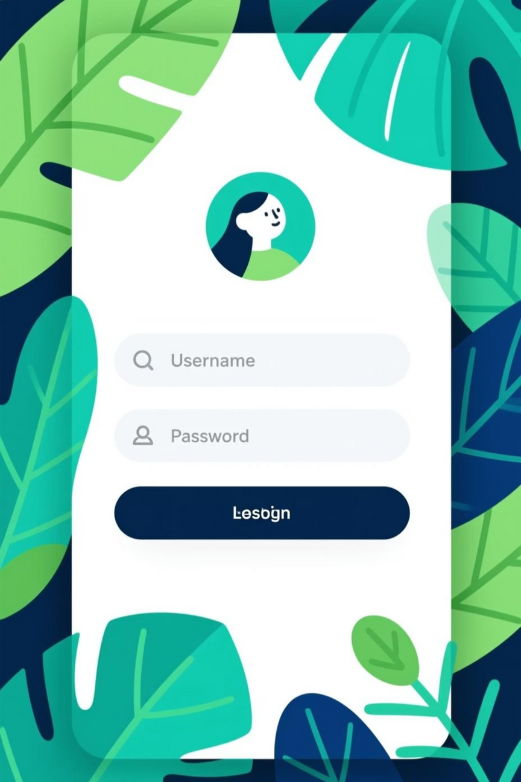
Module 1: Login Module
Ahmed Ali – Automation Tester
1
LoginPage Structure
Organized page object with locators and methods
2
Test Scenarios
Valid login, Invalid login, Error message validation
3
Locator Strategy
ID, CSS, XPath for element identification
4
Assertions & Verification
Comprehensive validation steps for each scenario
Challenges & Solutions
Dynamic Validation Messages
Timing Issues
Handled with explicit waits and dynamic locators
Resolved using explicit waits instead of hard sleeps

Slide 16
Module 2: PIM Module
Kerolos Samuel – Automation Tester
Page Objects Implemented
PimPage
AddEmployeePage
EmployeeListPage
Main PIM module page object
Employee creation functionality
Employee listing and search
Test Cases Automated
Add Employee
Search Employee
Edit Employee
Delete Employee
Filter and advanced search
Implementation Highlights
Locator strategies for dynamic tables, reusable methods, explicit waits, actions, and data-driven testing

Slide 17

Module 3: Admin Module
Mohamed Goda – Automation Tester
Admin Page Responsibilities
Add User
Search User
Create new user accounts with roles and permissions
Locate users by various criteria
Edit User
Delete User
Modify user details and access levels
Remove user accounts from system
Technical Implementation
Locating dynamic table rows, handling dropdowns and user roles, managing complex interactions
Challenges & Solutions
Dynamic table elements handled with robust locator strategies, dropdown selections managed with explicit waits and action chains

Slide 18
Module 4: MyInfo Module
Zeyad Osama – Automation Tester
Page Objects Implemented
MyInfo Page
Personal Details Page
Contact Details Page
Main module object containing navigation and section access
Handles fields like name, employee ID, gender, nationality, DOB, and marital status
Phone numbers, addresses, email, and postal information.
Test Cases
Update Personal Details
Validate Minimum Age Requirement
Upload & Remove Profile Picture
Field Validation (required fields, formats, dropdown consistency)
Challenges & Solutions
Dynamic Form Behavior (Different sections load dynamically and require accurate waits)
✔Solved using explicit waits, stable locators, and field readiness checks
Validation Rules (DOB, email format, phone formats, and required fields vary across sections)
✔Implemented robust negative test scenarios and validation message assertions

Slide 19



Test Cases Summary
Team Member
Module
Test Cases
Ahmed Ali
Login Module
3 scenarios
Kerolos Samuel
PIM Module
5 scenarios
Mohamed Goda
Admin Module
4 scenarios
Zeyad osama
MyInfo Module
1 scenario
Coverage Overview
3
5
4
1
Login Tests
PIM Tests
Admin Tests
MyInfo Tests
Ahmed Ali
Kerolos Samuel
Mohamed Goda
Zeyad Osama

Slide 20

Execution Flow
Launch WebDriver
Initialize browser and navigate to OrangeHRM
Login
Authenticate with valid credentials
Navigate Module
Access requested module (Login, PIM, or Admin)
Execute Scenario
Run automated test case steps
Validate Results
Assert expected outcomes
Generate Reports
TestNG reports with detailed results

Slide 21
Challenges, Solutions & Achievements
Challenges & Solutions
Dynamic Web Elements
Slow Loading Pages
Implemented robust locator strategies and dynamic XPath expressions
Solved with explicit waits and proper synchronization techniques
Repetitive Actions
POM Structure Consistency
Solved with reusable utilities and helper methods
Maintained clean architecture across all 3 modules
Final Results & Achievements
Full automation coverage for Login, PIM, Admin modules
Clean and scalable Page Object Model architecture
Strong teamwork and clear task division
High test pass rate across all scenarios
Ready to expand automation to more modules

